Slide 1
Business Communication
FYBCOM
Semester – I
Prof. Muskan Jeswani

Slide 2




Why this subject in your First Year?
COMMUNICATION
SKILL

Slide 3
Syllabus for Semester I
Unit 1 – Fundamentals of Communications
Unit 2 – Written Communication
Unit 3 – Oral Communication
Unit 4 – Non-verbal communication and business etiquettes

Slide 4
Unit 1 – Theory of Business Communication are as follows:
Concept – meaning, definition, process
Importance of corporate communication
Modern methods of communication – web context, blogs writing, video and teleconferencing
Formal channels of communication alongwith objectives – vertical, horizontal and consensus.
Informal channels – Grapevines
Barriers to communication – physical / environmental, language /semantic, socio-psychological, organizational, cross-cultural and overcoming the barriers with case studies.

Slide 5
1. The Concept of Communication
Introduction to Communication:
The English word ‘communication’ has been derived from the Latin word, ‘Communicare’ which means to impart or participate or to transmit. The word ‘Communicare’ is derived from the root ‘Communis’ which means to make common or to share.
Communication is 1) the activity or process of sharing or exchanging ideas, feelings, information, experience between two or more persons; 2) an act or instance of transmitting; 3) the information actually communicated by some means.

Slide 6
Definitions of communication:
The Oxford English Dictionary defines communication as “the action of conveying or exchanging information and ideas.”
Keith Davis defines communication as “Communication is the transfer of information and understanding from one person to another.”

Slide 7
Features of Communication
Communication is Unintentional as well as Intentional
Communication is a Dynamic Process
Communication is Systemic
Communication is Both Interaction and Transaction

Slide 8
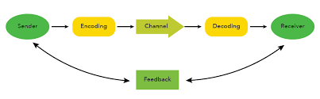
Process of Communication
written
Face to face
Phone
Electronic

Slide 9
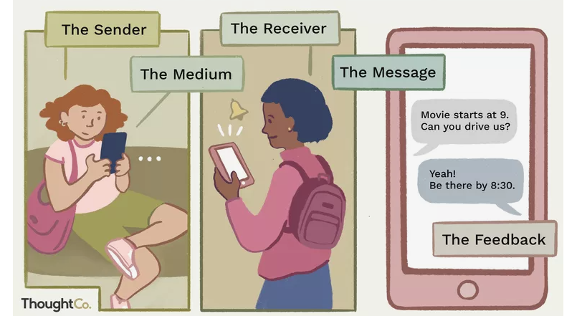

Slide 10
Importance of feedback in the process of communication
Helps to take important decisions
Feedback helps the sender to believe that his message is conveyed rightly.
Two types of feedback. Positive and Negative feedback.
Feedback can be immediate or delayed.
Feedback in business is of utmost important.

Slide 11
Impact of Technology on Communication
https://www.youtube.com/watch?v=SvIrLC7bCjQ

Slide 12
THANK YOU!!

